Slide 1
Fancy
Trees

Slide 2
Expression Tree
A binary expression tree is a binary tree
in which each parent node contains an operator and each leaf contains a number.
+
4-5+6*7
-
*
4
5
6
7

Slide 3
Threaded Tree
A threaded binary tree is a binary tree
with an additional reference in each
node that is used to point from a child
back to its parent.

Slide 4
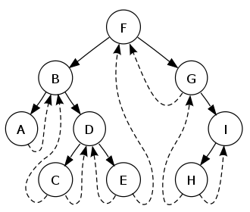
Threaded Tree

Slide 5
Threaded Tree
public class ThreadedTreeNode {
private Comparable treeNodeValue;
private ThreadedTreeNode leftTreeNode;
private ThreadedTreeNode rightTreeNode;
private ThreadedTreeNode parentTreeNode;
//constructors and methods not shown
}

Slide 6
Threaded Tree
null
50
35
70
null
null
null
null

